Slide 1

Python Fundamentals
Innovation Masters
Day 14

Slide 2

Warm Up Questions
Today’s topic: Methods

Slide 3
Profile maker for CIA
Lists
Use lists to store different information about a person
Info
Name, age, nationality
Separate
Have a separate list for each type of information
Ask
Ask user how many profiles he wants to make
Store
Store the information in each list
Print out
Finally print out the profiles nicely

Slide 4
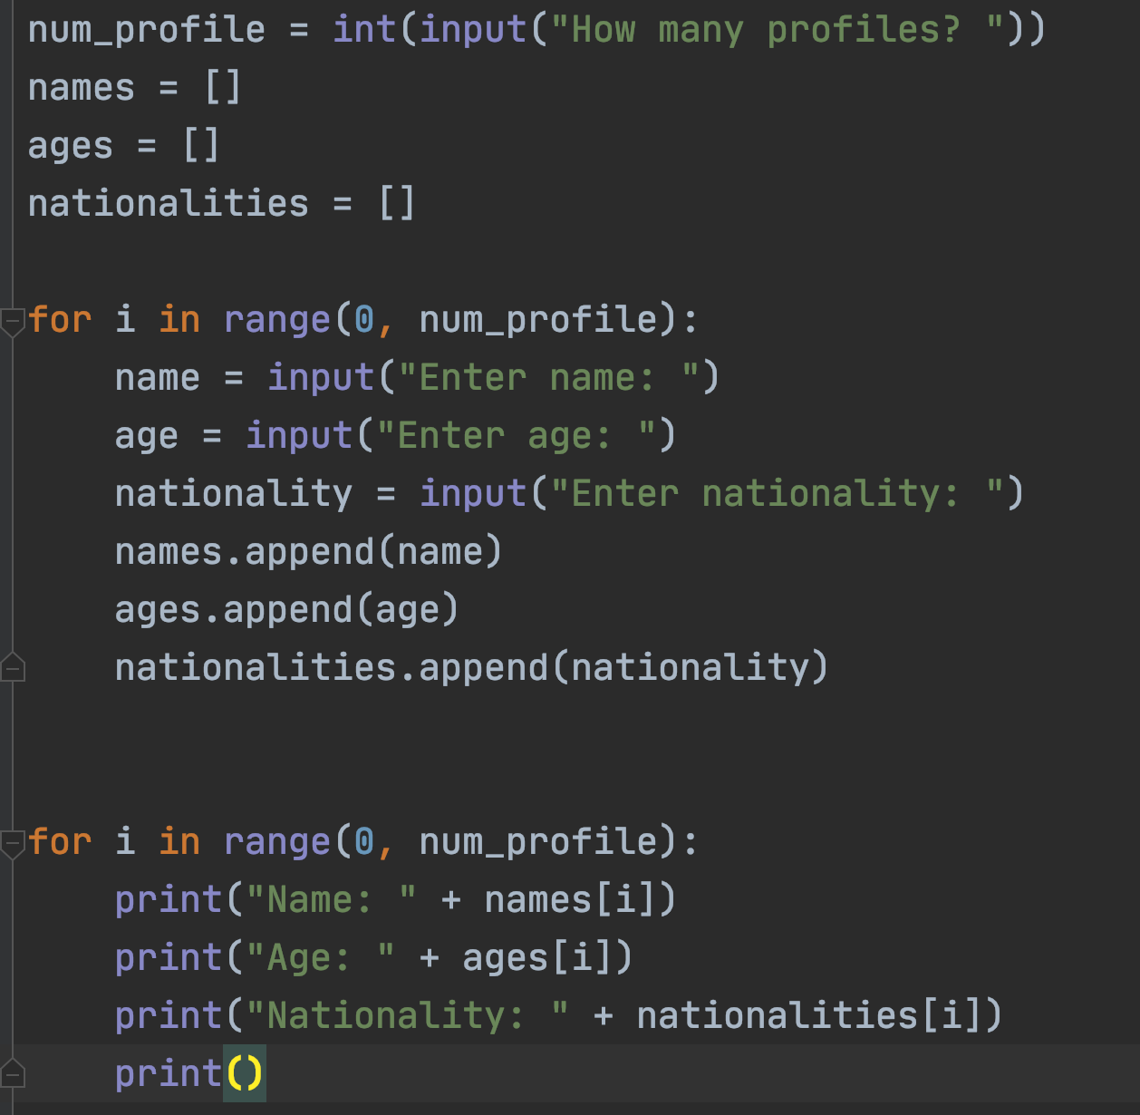
Solution

Slide 5
Was there a better way to do this?
Yes there is!
We can make objects to store name, age, and nationality bunched together.
An object can have different variables.
You can think of an object as a bigger variable that holds smaller variables.

Slide 6
Conceptualizing an object
Person
Name
Age
Nationality

Slide 7
Object is the instance of a class
Definition of person
Name
Age
Nationality
Rifat Alam
22
Bengali
Person 1
Aaron Golf
36
Polish
Person 2

Slide 8
Syntax of making objects
First, we must define a class
A class is like the general definition or blueprint of an object
From the class definition we can make (instantiate) as many objects of the same type as we want
Class is the blueprint – Object is an instance of that class
Examples:
Class: Human, Objects: Rifat, Matt, Fahad, Tony, Cindy, Pat
Class: Integer, Objects: 2, -3, 79

Slide 9
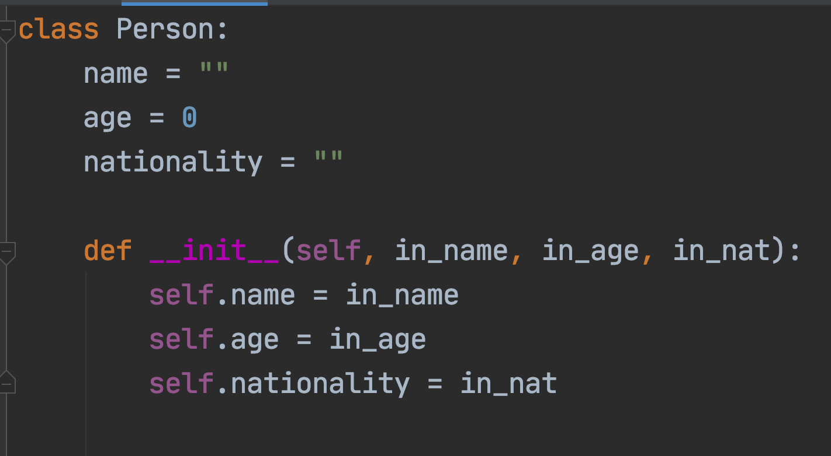
Let’s make a Person Class
Constructor

Slide 10
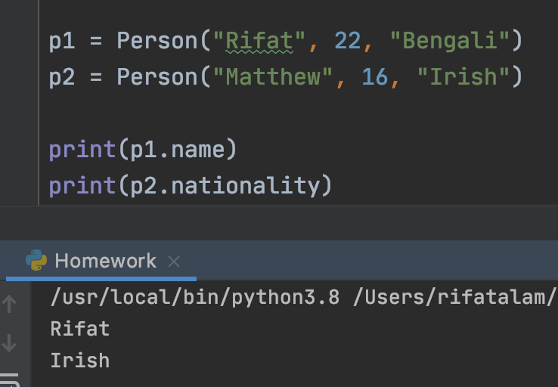
Instances of Person
Now we can make objects of Person class
Each of the object is like a variable and it has a name
The objects have the same placeholder variables, but the data stored in them will vary from object to object

Slide 11
Accessing variables and methods of an Object
Syntax: object_name.variable
We write the name of the object and then put a dot.
After the dot we can refer to its variables and methods.
For methods: object_name.method()

Slide 12
How to retrieve information?
Now let’s try to retrieve information for a specific person
We can use their name to get all the other information
Ask the user for a name
Display all the relevant information regarding that person

Slide 13

More on Objects
We can also update variables of an object
Let’s give Person some more features
Also make some methods for Person

Slide 14
Homework
Make a Rectangle class
Variables: length, width
Methods: area(), perimeter()
Hint: area = length*width, perimeter = 2L + 2W
Make 5 objects of rectangle class taking user input
Store the 5 objects in a list
Print out area and perimeter of each rectangle
Print out sum of area of all objects
Print out sum of perimeters of all objects

Slide 15

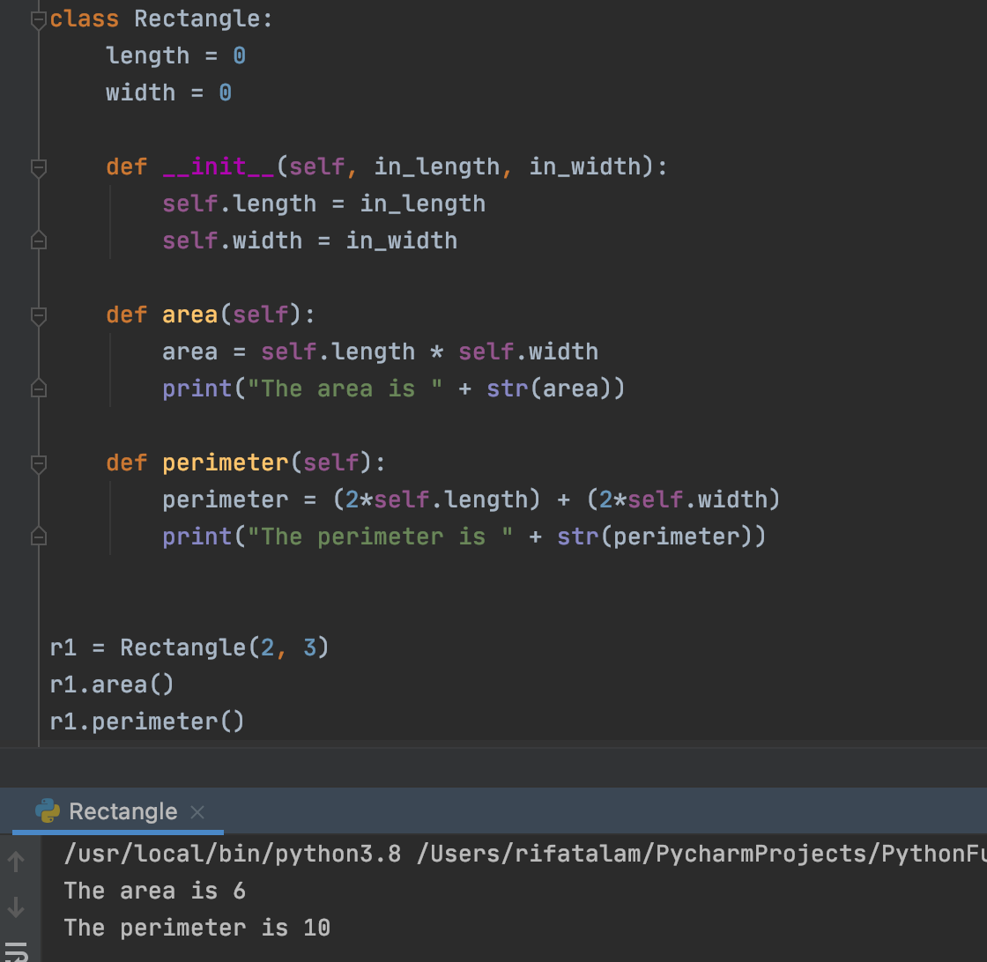




Solution

Slide 16
Tech Talk
We will watch snippets of backyard science
How to make a compass
How to make a water filter
Using static electricity to separate salt and pepper
https://www.youtube.com/watch?v=g1VVbKk_OSY&t=968s

